Slide 1

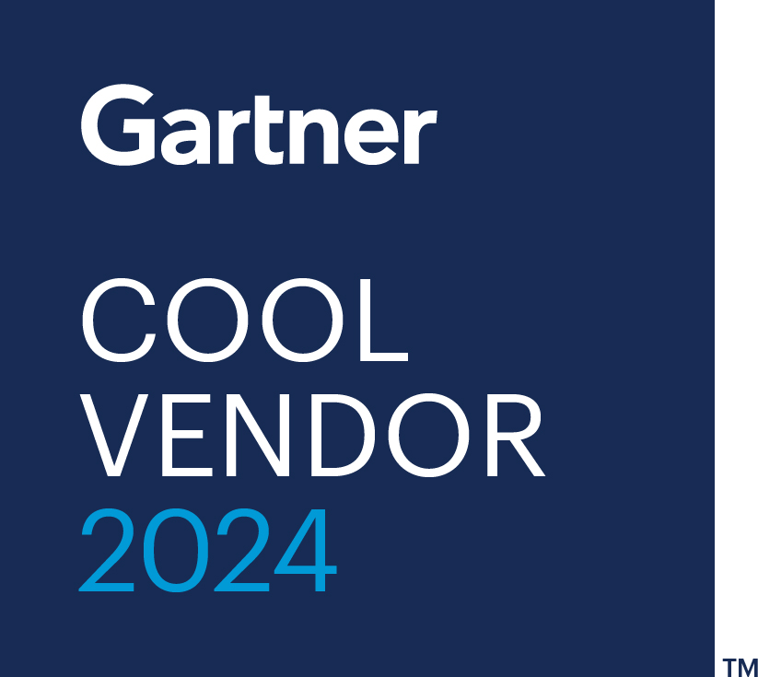
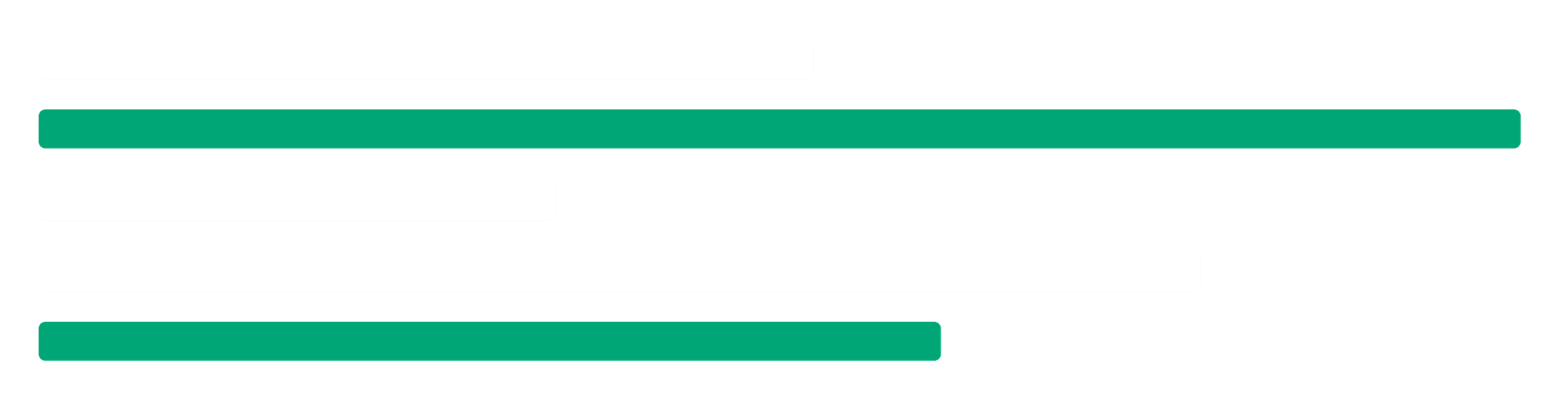
FOR ENTERPRISE & MANUFACTURING
DATA CENTRE · SERVER ROOM · PLANT · COLOCATION · CLOUD
Capital decisions, made right first time.
Wherever you buy servers at scale, the decision can be evidenced. We put measured evidence under the spend and the decision behind it, so the next hardware you buy is the right hardware.
55%
100,000s of benchmarks · 500+ data centres · 9 years of research
Less cost and energy, no new risk.
Notes:
Open: this is not about data centres. It is about a large hardware spend where the evidence is thinner than the cheque deserves. We fix that.

Slide 2



1 · TWO WAYS IN
Two paths. One route.
01 · SELF-SERVE SOFTWARE & TOOLING
02 · STRATEGIC PARTNERSHIP
Interact Verify
Interact Advisory
“Buy & change better.”
“Buy well, every time.”
›
Benchmark your estate and model the options on the table
›
A senior counterpart who knows your estate
›
See cost, power & footprint before you commit
›
Finance and IT signing off the same number
›
A decision-ready recommendation in days
›
Support through to executed change
Typical payback inside the first quarter.
Senior partnership on the decisions that carry the most weight.
Verify evidences the decision in front of you. Advisory makes it a programme : strategic, programmatic cost optimisation, run continuously across the group with simulation.
Notes:
Two ways to engage. Verify: self-serve tooling to model options. Advisory: senior partnership on the decisions that carry the most weight. Same dataset behind both.

Slide 3
2 · THE PROBLEMS
Five decisions you can't afford to guess.
01
02
03
04
05
Buying big, knowing less
Finance and IT on different numbers
A decision you can stand behind
Over-buying to be safe
Buying the same by default
The size of the purchase far outweighs the hard data sitting behind it.
Cost, performance and carbon judged separately, so no one signs the same figure.
The reasoning behind the spend, clear and ready to share with anyone who asks.
Capex, power and carbon spent on a margin of safety no one has measured.
Like-for-like feels safe, but the best output per pound is rarely the obvious option.
Notes:
Five challenges an enterprise IT or procurement buyer knows well. These are the risks measured evidence removes.

Slide 4
3 · HOW WE SOLVE THEM
The same five, answered with evidence.
THE CHALLENGE
HOW WE SOLVE IT
THE OUTCOME
01
Buying big, knowing less
Measured evidence under the spend, supplementing your team's expertise
100,000s
benchmarks behind it
02
Finance and IT on different numbers
Cost, performance, energy and carbon scored together as one number
One
number both sign off
03
A decision you can stand behind
An evidence pack that holds up to board, audit and regulatory scrutiny
100%
traceable to measured data
04
Over-buying to be safe
Right-sized against measured performance, no new risk in the estate
55%
less cost & energy
05
Buying the same by default
Every option ranked on measured output per pound, not habit
143%
more capacity at SHI
Notes:
Each problem answered by measured evidence. Same five, now with the outcome Interact delivers.

Slide 5
4 · PROOF
SHI ITAM LAB
Optimising lab energy efficiency.
THE SHIFT
A refurbished reconfiguration moved the lab from a grade C to an A for energy efficiency, a 148% gain in performance per watt.
SHI needed to grow their own ITAM lab while reducing environmental impact. A refurbished reconfiguration saved over 65% in procurement costs and cut energy use 40%, while increasing capacity 143%.
Scope 3 impact cut from 4,500kg to 40kg CO2e
65%
40%
143%
Procurement saving
Energy reduction
Increased capacity
Notes:
SHI ITAM Lab: refurbished reconfiguration saved 65% procurement, cut energy 40%, increased capacity 143%, moved C to A grade.

Slide 6

GET STARTED
Make it right the first time.
Bring us the hardware spend you are about to make. We will put measured evidence under it, and tell you what the data says.
Let's Talk →
interactdc.com/contact
interact.
Buy & change better. With evidence.
Notes:
Close: bring us the decision you're weighing and we'll tell you what the data says.

